Slide 1

CMSC 608
ADVANCED DATABASE
VCU Student Housing and Roommate Matching
Abhishek Vajragattepalya Seetharamaiah Neha Reddy Annapureddy
Nikitha Vinod
Nikhitha Vemula
Notes:
"Good [morning/afternoon], everyone. Today we are excited to present our project for CMSC 608 - Advanced Database Systems. Our project is VCU Student Housing and Roommate Matching, developed by Abhishek Vajragattepalya Seetharamaiah, Neha Reddy Annapureddy, Nikitha Vinod, and Nikhitha Vemula. Let’s dive into the details."

Slide 2

DATA BYTES
CMSC 608 – ADB
Agenda
Introduction to the project
Literature & background
System design overview
Implementation details
Demonstration
Future work
Conclusion
Q&A
Notes:
"Here's what we’ll be covering today: We'll start by introducing the problem we’re addressing, followed by the literature and background that guided our approach. Then, we’ll walk you through the system design, implementation details, and a live demonstration. Finally, we’ll discuss future work, conclude the project, and open the floor for any questions."

Slide 3
DATA BYTES
CMSC 608 – ADB
Introduction
Students face challenges finding affordable housing and compatible roommates.
Our project provides an automated housing and roommate matching platform.
High administrative overhead in traditional processes
Lack of personalization in roommate assignments
Objective: Streamline and personalize housing
Notes:
"Finding affordable housing and the right roommate can be a really stressful and overwhelming experience for students.
Traditional methods often involve piles of paperwork, random roommate assignments, and honestly — a lot of luck. Despite all the effort, there's very little personalization, and administrative tasks can be extremely heavy for both students and staff.
Recognizing these challenges, we set out to create a solution that automates the process while making it truly personalized.
Our goal is simple: to make housing selection less stressful, much more accurate, and better aligned with each student's lifestyle and personal preferences — creating a smoother and more satisfying experience overall."

Slide 4
DATA BYTES
CMSC 608 – ADB
Literature Review
Emerging need for AI-driven matching
Importance of dynamic user-centric design
Benefits of real-time adaptability
Existing platforms: Roomsurf, Roomi
Notes:
"As we began our research, we noticed a growing interest in AI-driven platforms that adapt dynamically to user preferences. Platforms like Roomsurf and Roomi exist, but they have limitations — they often lack real-time adaptability and deeper personalization. The literature emphasized the importance of placing the user at the center of the matching process, allowing the system to evolve as preferences and availability change. These insights heavily influenced our system design, ensuring that the user experience remains dynamic and continuously updated."

Slide 5
DATA BYTES
CMSC 608 – ADB
Evolution of Housing Portals
Physical bulletin boards and paper forms
Manual roommate pairing based on paper forms
In-person interviews and static listings
High error rates and delays
Limited student involvement
Most focus on listing availability
Notes:
"If we look at the history of housing portals, the evolution has been slow. Initially, students relied on bulletin boards and physical paper listings, often requiring multiple in-person visits and interviews. Later, digital listings made housing more accessible but still lacked personalization. The focus remained on availability — not compatibility. High error rates, delays, and dissatisfaction persisted because the process didn’t adapt to the actual needs and personalities of students. Our project seeks to fix that gap."

Slide 6
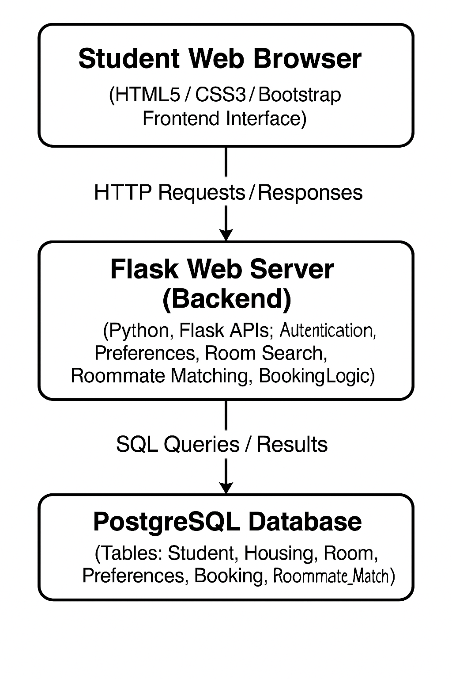
DATA BYTES
CMSC 608 – ADB
System Architecture overview
Frontend: HTML5, CSS3, Bootstrap, JS
Backend: Flask RESTful APIs
Database: PostgreSQL schema
Modular three-layer design
Notes:
"Our system architecture is built around a clean, modular three-layer design.
First, the Frontend Layer uses HTML5, CSS3, JavaScript, and Bootstrap 5 to create a responsive and intuitive user interface. Students can easily register, view housing listings, and update preferences across devices with a consistent experience.
Next, the Backend Layer is developed using Flask, providing RESTful API endpoints for authentication, preference management, listing updates, and roommate matching. This modular backend design ensures flexibility, maintainability, and future scalability.
Finally, the Database Layer uses PostgreSQL to store all critical data — from student profiles and preferences to bookings and match results. We focused on ensuring referential integrity and optimized performance through proper indexing and normalization.
Together, this layered approach enables a fast, scalable, and user-centric platform, laying the groundwork for future upgrades like cloud hosting, AI integration, and smart dormitory support."

Slide 7
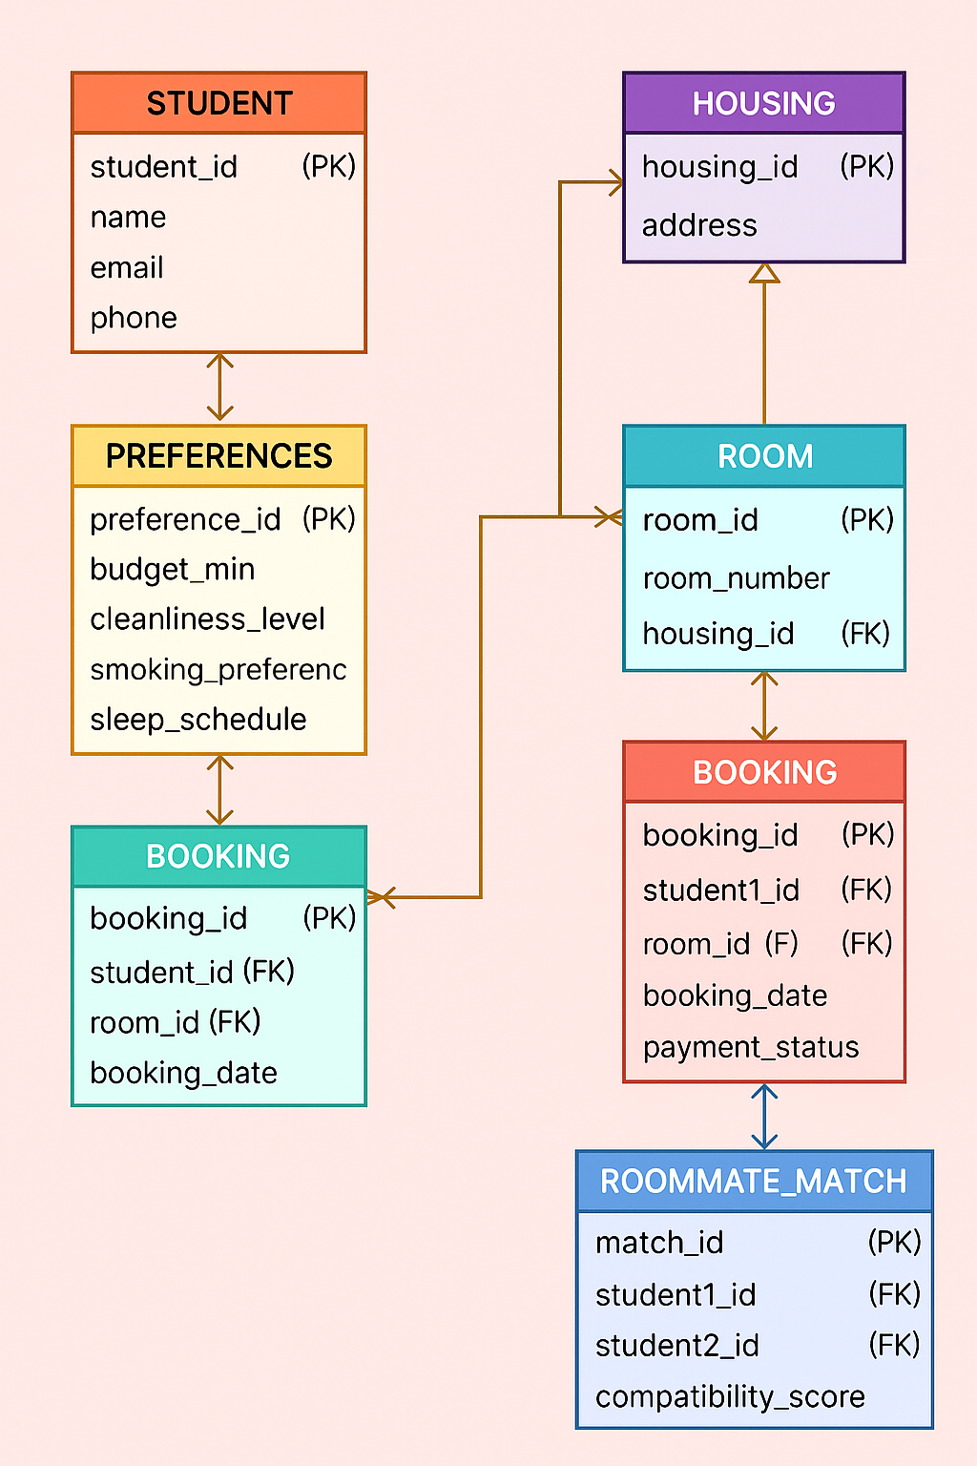
DATA BYTES
CMSC 608 – ADB
Crow’s Foot Diagram
Notes:
"This slide represents the database schema for our student housing management system
We have six main entities here:
Student: Stores student details like student ID, name, email, and phone number.
Preferences: Captures the student’s housing preferences, such as budget, cleanliness level, smoking preference, and sleep schedule.
Housing: Represents different housing locations, identified by a unique housing ID and address.
Room: Each housing has multiple rooms. The Room table contains the room number and links back to its housing location.
Booking: Manages the relationship between students and the rooms they book, including booking date and payment status.
Roommate Match: Helps in matching two students based on their compatibility score, promoting better roommate pairing.
The arrows show the relationships between these tables. For example, a student is linked to preferences and bookings, and rooms are linked to specific housing.
Overall, this schema is designed to efficiently manage student preferences, room availability, bookings, and roommate compatibility, all in one integrated system."

Slide 8
DATA BYTES
CMSC 608 – ADB
Need for Database
Centralized storage for students, preferences, housing, and bookings.
Real-time updates for room availability.
Supports matching and booking tracking.
Notes:
The need for a dedicated database arose because traditional methods of managing student housing and roommate matching were inefficient, error-prone, and lacked personalization.
Our portal centralizes all critical information — student profiles, their preferences, available housing options, and booking details — into one streamlined system.
It allows real-time updates on room availability, ensuring students have the most up-to-date information when making housing decisions.
Lastly, it supports intelligent roommate matching and tracks bookings efficiently, improving the student experience while also reducing the administrative burden for the university."

Slide 9
DATA BYTES
CMSC 608 – ADB
Implementation details
User surveys and focus groups
ERD and flow diagrams creation
Mock student and housing datasets
Referential integrity and consistency checks
Scoring criteria: budget, cleanliness, smoking, sleep
Pseudocode and flowchart of matching algorithm
Test-driven development practices
Performance and load testing results
Notes:
Our project followed a structured development process:
We started with user surveys and focus groups to gather real-world requirements.
Then, we designed Entity Relationship Diagrams (ERDs) and system flow diagrams to lay out the relationships and data flow clearly.
We created mock datasets for students and housing units to simulate real-world conditions and ensure smooth integration.
Referential integrity and consistency checks were enforced in the database to prevent errors.
The roommate matching is based on weighted scoring of preferences like budget, cleanliness, smoking habits, and sleep schedules.
We also developed pseudocode and flowcharts for the matching algorithm to ensure logical flow and easy debugging.
Test-driven development practices were adopted to maintain reliability. Finally, performance and load tests were conducted to verify that the system could handle multiple users without slowdowns."

Slide 10
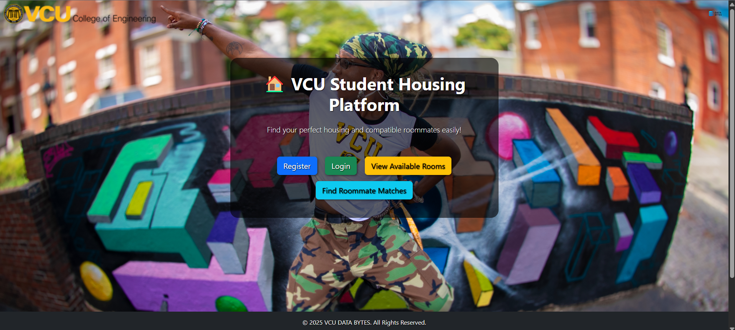
DATA BYTES
CMSC 608 – ADB
Home Page

Slide 11
DATA BYTES
CMSC 608 – ADB
Demonstration

Slide 12
DATA BYTES
CMSC 608 – ADB
Environmental and Social Impact
Reduction in paper-based processes
Lower carbon footprint from virtual tours
Improved student well-being and retention
Enhanced campus sustainability metrics
Notes:
"Beyond convenience, our project offers real environmental and social benefits. By digitizing the housing search and roommate matching process, we significantly reduce the need for paper forms and manual administrative work. Virtual tours help lower carbon emissions associated with in-person visits. Better roommate matches also enhance student well-being, leading to higher campus engagement and retention. This platform contributes directly to VCU’s broader sustainability goals."

Slide 13
DATA BYTES
CMSC 608 – ADB
Key Features
Registration and Login
Housing listing and availability
Roommate matching based on preferences
Booking and conflict management
Dynamic backgrounds, Flash messages
Notes:
"Some of the key features that set our platform apart include secure student registration, real-time housing availability, preference-based roommate matching, and conflict management tools. We also incorporated dynamic UI elements like flash messages for user feedback and customizable backgrounds for better engagement. All these features come together to create a modern, efficient experience for students."

Slide 14
DATA BYTES
CMSC 608 – ADB
Future Work
Federated ML and privacy-preserving matching
Cloud deployment and IoT integration
Implement federated learning for privacy
Integrate IoT data for roommate insights
Deploy on AWS with CI/CD pipelines
Enhance the algorithm with ensemble methods
Notes:
"Our vision for the future is ambitious. We plan to incorporate federated machine learning models to protect user data privacy even during match processing. We also envision integrating IoT devices — for example, using smart sensors to understand students' living preferences even better. Cloud deployment using AWS and automated CI/CD pipelines will help us scale and maintain the platform seamlessly. And finally, enhancing the matching algorithm using ensemble methods will make roommate predictions even more accurate."

Slide 15
DATA BYTES
CMSC 608 – ADB
Conclusion
Created a scalable student housing and roommate matching platform.
Applied backend, frontend, and database skills.
Improved housing search experience through technology.
Notes:
"In conclusion, through this project we have designed and implemented a scalable, efficient, and user-centric housing and roommate matching platform for students. We successfully combined backend development, frontend design, database architecture, and dynamic matching algorithms to create a solution that truly improves the student housing experience. This project is not just a technical achievement — it’s a step towards better, smarter, and more sustainable campus life."

Slide 16
Explainable AI
CMSC 636 – NDL
Thank You
Any Questions…?
Notes:
"Thank you for your attention! I hope this presentation has provided insights into the challenges and potential solutions in the field of Explainable AI. If you have any questions or would like further discussion on any topic, feel free to ask."

